Slide 1



Real-time Optimization of Advertising Content
+
Tom Vodopivec
IADS Analytics, Data Science & Decision Making Summer School 2022 2022-08-01
Notes:
Neural network = a way of how to store data instead of a matrix dataset structure (i.e., uses weights)
Deep learning = a lot of neural networks, mainly working with efficient storage and retaining of information, but has some overlap with reinforcement learning = which is a problem solivng methods

Slide 2


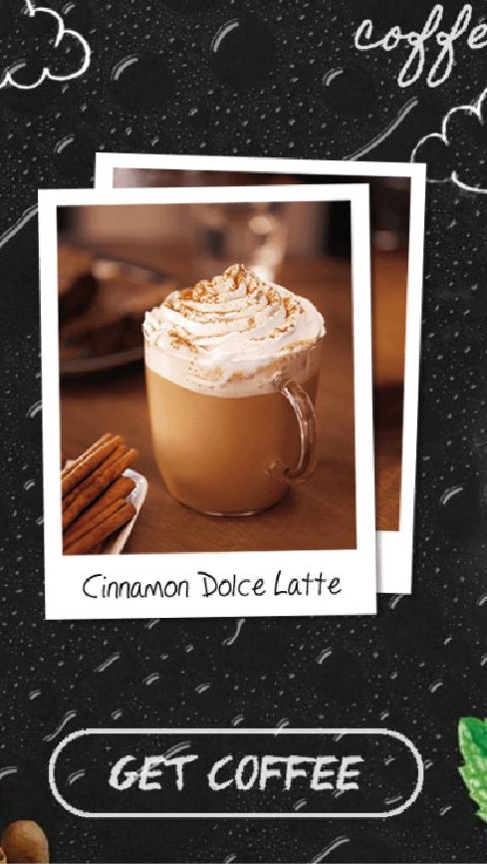




Slide 3
Choosing the best variant e.g., diff types of ads -> which one will perform better?
Difficult for marketers to predict which variant will perform better
Depends on specific environment (rural vs city, young vs old audience… )
Might change with time (!!)
Possible solution: automated real-time optimization
3/24

Slide 4
Business goal
Develop methodology to achieve as high performance as possible and measure it with confidence to show it to clients.
‘’measure with confidence’’ = have data and metrics that using your algorithm is working better than not using it. E.g., ‘’reached 10% more people of target audience..’’ = have an argument for your claims by having results.
4/24

Slide 5
Project goals
Measure the performance of the DCO system
Estimate theoretical potential of DCO optimization in Celtra campaigns i.e., does it even make sense to optimize, do we have theoretical reasons to believe it will improve, before we invest time and resources.
Estimate how much of the theoretical potential can algorithms achieve Improve performance of the algorithms = research and develop new ones
5/24

Slide 6
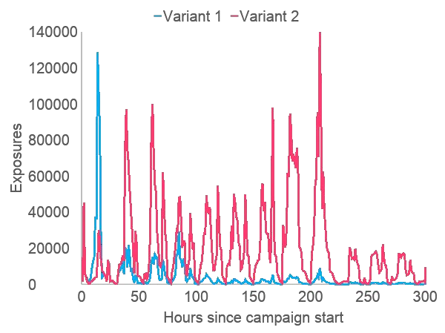
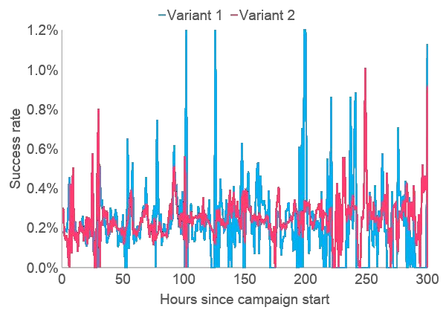
An advertising campaign
6/24

Slide 7
Evaluating the performance
Measure of performance – lift ( = metric -> used to see how much your algorithm improves vs a baseline performance of a random algorithm).
=ratio metric Successes of optimization algorithm / successes of random algorithm
Measure of potential – lift of an oracle optimization algorithm
7/24

Slide 8
Challenges and solutions
Address the exploration-exploitation dilemma > bandit algorithms Solution: ε-greedy, Thompson sampling, UCB algorithms
Real-time optimization causes selection bias > compute only from unbiased data e.g., one run one note/branch gives a 0 = will lead your algorithm to never choose that one again, even though the 0 was an accidental one time outcome.
Need a control set for unbiased analysis
Solution: Three-set sampling

Slide 9
Challenges and solutions
Technical limitations: feedback delayed and in batches (e.g., every hour you get an aggregated info dump of everything that happened in the past hour, so can only update with new info = every hour)
Solutions: prediction + simulated feedback
Non-stationarity = database constantly changing and updated, e.g., people in USA active different times than in Europe.
Solution: Detection of abrupt changes in trends (e.g., activity users)
Solution: Forgetting
Solution: Two-memory structure

Slide 10
Additional Challenges and solutions
Obtaining samples is expensive
Low success rates - noisy data, few samples
Solution: Estimation of confidence bounds (Fieller‘s theorem)
How to compare different algorithms??
Solution: Creation of artificial campaigns as an approximation of real campaigns

Slide 11
Artificial campaigns
Correction coefficient
Smoothing coefficient Best-case scenario
Two worst-case scenarios

Slide 12

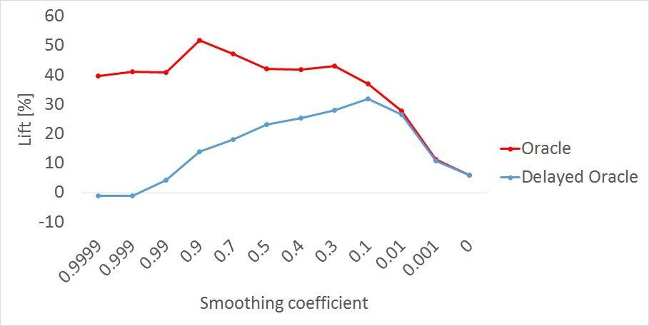

Best case
Worst case – low smoothing
Worst case – high smoothing

Slide 13
Data and experiments
Hundreds of real campaigns Up to 10 variants
Up to 10 million exposures Up to 6 months of duration
Best-case and worst-case sets of artificial campaigns Multiple repeats on each campaign for each algorithm

Slide 14
Results: potential in campaigns
How much potential is there?
26% – 55% of campaigns have at least 5% potential lift 18% – 53% of campaigns have at least 10% potential lift 18% – 34% of campaigns have at least 20% potential lift
Roughly one in four campaigns has meaningful potential

Slide 15
Results: efficiency of optimization
In how many campaigns with significant potential can the algorithms achieve at least 5% lift?
Thompson sampling UCB
Augmented Thompson sampling Augmented UCB
in 25% – 39% of campaigns
in 30% – 44% of campaigns
in 36% – 55% of campaigns
in 34% – 59% of campaigns
The algorithms can exploit roughly half of the potential

Slide 16
Algorithm | Ratio [%] of artificial campaigns with lift above
 | 5 % | 10 % | 20 %
Original TS | 39 | 27 | 16
+ periodic forgetting | 48 | 32 | 23
+ two-memory | 51 | 37 | 29
+ prediction | 55 | 36 | 30
+ change-point detection | 55 | 36 | 30

Slide 17
Summary
Metric for performance of content-optimization algorithms
Metric for potential in advertising campaigns Methodology for measuring algorithm performance Evaluation of algorithms
Improvements for algorithms

Slide 18
Future and Conclusion
Potential improvement to algorithms' performance
Dual-layer UCB Budget-limited bandits
Optimal ratio of three sampling sets
Signal processing and time-series prediction
Can't optimise if there is nothing to optimize
Correlate campaign features with campaign potential (learn what to do to have exploitable potential) Inform and educate designers who create advertising campaigns
Impact on economy could be massive -> but for that often also need a massive effort to convince people to turn algorithm into practice.

Slide 19


References
Our conference paper: Vodopivec et al., Real-time Content Optimization in Digital Advertisement, 2017, pages 97-100
Fieller’s theorem: Fieller, Some Problems in Interval Estimation, 1954
Variance and covariance estimation: Moineddin et al., On the Location Quotient Conﬁdence Interval,
+
Two-set sampling (un-biasing the data): Xu et al., Estimation Bias in Multi-Armed Bandit Algorithms
Search Advertising, 2013
Bandit algorithms: Kuleshov and Precup, Algorithms for multi-armed bandit problems, 2014 Change detection methods: Sebastiao and Gama, A study on change detection methods, 2009
Budget-limited multi-armed bandit algorithms: Tran-Thanh et al., Knapsack based optimal policies for budget-limited multi-armed bandits, 2012

Slide 20
4. Improve performance
List algorithms we tested
Near-zero success rate (can’t do much) > tell client that campaigns need to have enough samples (we can estimate how much)
+
Batch updates, algorithm less optimal due to ﬁxed action-selection distribution for whole hour (can mitigate)
- simulate reward after each selection (or use dedicated bandit algorithms, however issue is also that “budget” for the hour is unknown)
20

Slide 21
Near-zero success rate (can’t do much) > tell client that campaigns need to have enough samples (we can estimate how much) -> need 10k to 10M impressions (depends on success rate and vairant) for oracle lift lower bound above 0%
+
Batch updates, algorithm less optimal due to ﬁxed action-selection distribution for whole hour (can mitigate)
- simulate reward after each selection (or use dedicated bandit algorithms, however issue is also that “budget” for the hour is unknown) -> a set of “simualted” samples that gets replaced by “real” samples at each hour
Delayed updates (can mitigate) > time-series prediction (for generating the simulated samples between each batch update)
21

Slide 22
Non-stationarity - overﬁtting to same scenario (e-greedy very poor here) (can mitigate)
forgetting (params: strength and frequency)
+ periodic (on time, exposures, or successes)
+ statistical change-point detection (Page-Hinkley test)
two-memory structure (long-term and short-term / permanent and transient), forgetting for each + weight of each
+
Need for a control set (trade-off between “achieved” lift and “measurable” lift) (can mitigate)
- three-set sampling (evaluation, learning, random)
22

Slide 23
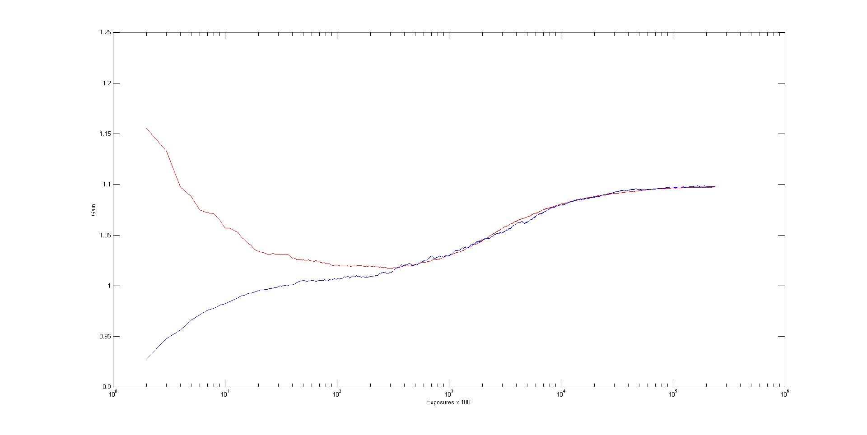
Generating artiﬁcial data
< correction and smoothing pictures >
+
23

Slide 24
Best case
Worst case – low smoothing
Worst case – high smoothing
24

Slide 25
Artificial datasets
Dataset | Number of campaigns with oracle lift above 10 %
Best case | 20/38 (53 %)
Low smoothing | 12/38 (32 %)
High smoothing | 7/38 (18 %)
25

Slide 26
Results: TS vs. UCB on best-case dataset
Algorithm | Ratio [%] of artificial campaigns with lift above
 | 5 % | 10 % | 20 %
Original TS | 39 | 27 | 16
Original UCB1-Tuned | 44 | 35 | 19
Improved TS | 55 | 36 | 30
Improved UCB1-Tuned | 59 | 34 | 30
26

Slide 27
Results: Performance on all datasets
Dataset | Ratio [%] of artificial campaigns with lift above
 | 5 % | 10 % | 20 %
Best case | 59 | 36 | 30
Low smoothing | 44 | 30 | 12
High smoothing | 36 | 27 | 16
(Results given for best configurations of improvements)
27

Slide 28
Results: Exploited potential
Dataset | Algorithms‘ lift relative to delayed oracle [%]
 | Average | Median
Best case | 25.3 | 20.0
Low smoothing | 52.3 | 16.0
High smoothing | 34.3 | 37.0
(Results given for best configurations of improvements)
28

Slide 29
Summary
Selection method | Ratio [%] of valid real campaigns with lift above
 | 5 % | 10 % | 20 %
Oracle | 26–55 | 18–53 | 8–34
Celtra various algorithms | 7–12 | 6–9 | 3–8
Basic TS | 13–20 | 9–14 | 6–8
Improved TS/UCB | 19–31 | 14–18 | 8–16
Best algorithms exploit 25–50 % of potential
29

